Slide 1
IDEA SUBMISSION PPT
NAME: M.AKASH
REG NO: 3502210507
GOLLEGE:CSE-A, AVIT

Slide 2
PROBLEM STATEMENT :
Introduction to Gen A.I and simple LLM , Inference on CPU and fine-tuning of LLM Model to create a custom chatbot
This problem statement is designed to introduce beginners to the exciting field of Generative Artificial Intelligence (Gen AI) through a series of hands-on exercises. Participants will learn the basics of Gen AI, perform simple Large Language Model (LLM) inference on a CPU, and explore the process of fine-tuning an LLM model to create a custom Chat bots.
LLMs are limited by the significant cost and time required to train or fine-tune them. This is due to their large model sizes and data sets.In this article, we will demonstrate how to easily train and fine-tune a custom chat bot on readily available hardware.

Slide 3
Unique idea brief :
Alpaca is an instruction-following language model that is fine-tuned from Meta’s LLaMA model. Inspired by this project, we developed an enhanced methodology to create a custom, domain-specific chatbot. While there are several language models that one could use we selected Alpaca because it is an open model.
A Language Model (LM) is a statistical model that is trained to predict the next word in a sequence of words. A Simple Language Model (LLM) could refer to a basic or smaller version of a language model, typically used for tasks like text generation, machine translation, summarization, or answering questions based on given text.

Slide 4
Features Offered
Advantages and Considerations of CPU Inference:
Availability: CPUs are present in virtually all computing devices, from servers to laptops and smartphones, making them highly accessible for deploying models.
Cost Efficiency: Unlike GPUs or specialized hardware like TPUs, CPUs are generally more cost-effective for inference tasks, especially when handling moderate workloads.
Versatility: CPUs are versatile and capable of handling a wide range of tasks beyond deep learning, making them suitable for systems requiring diverse computational capabilities.
Limitations: CPUs are typically slower than GPUs for deep learning tasks due to their architecture, which can affect the speed of inference, especially with large models or complex computations.

Slide 5
Processflow
Fine-tuning involves taking a pre-trained language model and adapting it to perform a specific task or better understand specific types of data. To create a custom chatbot:
Preparation: Choose a pre-trained language model suitable for chatbot applicationS
Data Collection: Gather a dataset of conversational data relevant to the domain or style of chatbot you want to create.
Fine-Tuning: Fine-tune the pre-trained language model on your conversational dataset. This involves updating the model’s weights (parameters) with your data to adapt it to the nuances and style of the conversations it will engage in.
Evaluation: Evaluate the fine-tuned model to ensure it performs well on your specific chatbot task. This may involve measuring metrics like response coherence, relevance, and engagement.
Deployment: Once satisfied with performance, deploy your custom chatbot model to your chosen platform or integrate it into your application for users to interact with.
This process leverages the power of pre-trained language models while tailoring them to specific applications, enabling sophisticated conversational AI capabilities without starting from scratch.

Slide 6
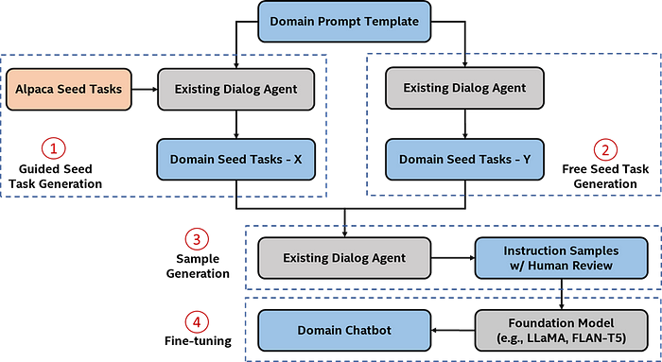
Architecture Diagram

Slide 7
Technologies used
We use the Low-Rank Adaptation (LoRA) approach to fine-tune the LLM efficiently, rather than fine-tuning the entire LLM with billions of parameters. LoRA freezes the pretrained model weights and injects trainable rank decomposition matrices into each layer of the transformer architecture, greatly reducing the number of trainable parameters for downstream tasks.
Besides the parameter-efficient fine-tuning, we can leverage hardware and software acceleration to speed up the fine-tuning process.

Slide 8
contribution:
We can also enable instruction sample concatenation to further improve the fine-tuning process. The basic idea is that several tokenized sentences are concatenated into a longer and concentrated sentence as the training sample instead of having several training samples with different lengths. This helps maximize the underlying hardware efficiency.
All the optimizations are on a single compute node. You can also perform multinode fine-tuning with distributed data parallelism during the fine-tuning process to harness more computing power.

Slide 9
conclusion
Incorporating inference on CPU and fine-tuning techniques allows you to create efficient and customized chatbot solutions. By leveraging pre-trained language models and adapting them to your specific needs, you can develop chatbots that understand and generate human-like responses tailored to different domains and use cases.

